Slide 1

ADITYA ENGINEERING COLLEGE(A)
DEPARTMENT OF COMPUTER SCIENCE AND ENGINEERING
FARMER’S TOUCH: HARNESSING TECHNOLOGIES TO ENHANCE CROP PRODUCTION
Batch No : 07
UNDER THE GUIDANCE OF
Dr. Ravi Kishore Veluri, M. Tech, PhD
Computer Science and Engineering
Aditya Engineering College (A)
PRESENTED BY:
Mohana Siri Vasamsetty (21A95A0506)
Yamuna Devi Buradakavi (20A91A0512)
Vishal Battula (20A91A0506)
Prahashit Jayanthy (20A91A0523)

Slide 2
CONTENTS
Abstract
Introduction
Problem statement
Aim & Objective of the project
Existing System and Disadvantages
Proposed system and Advantages
Literature Survey Comparison Table
Requirement Analysis(SRS/HRS)
Project Flow
Technology/Algorithm Used
Modules
UML Diagrams
Testing and Test cases
Results/Screens
Conclusion and scope for future work
References

Slide 3
ABSTRACT
The goal of agriculture inputs is to achieve high productivity regardless of conditions. Modern farming methods focus on efficient resource utilization by closely monitoring variables like soil condition, plant health, and crop yield. This approach saves resources, energy, and production costs.
Through this project, we are going to give customer and people who are want to maintain their own garden a proper guidance of what precautions and measures needs to be taken in order to get a good yield. User can also get a guidance through a chatbot.
The full-stack project will give a guidance not only for a specific part, we are providing guidance through different modules i.e., for soil, pests, machinery etc.
The technology stack that we’re using were Full-Stack for the web application and Machine Learning for Chatbot which was integrated using Flask API with a extra feature of Translator.

Slide 4
INTRODUCTION
The agriculture Web Guidance System is a full stack project where content highlights the shift towards precision agriculture, emphasizing its use of advanced technologies to optimize productivity while minimizing resource consumption.
The project described aims to provide actionable insights and guidance to agricultural enthusiasts and gardeners through web-based tools and a machine learning-powered chatbot.
By focusing on user accessibility and engagement, the project fosters a virtual community for knowledge sharing. It outlines the technological framework integrating full-stack web development and machine learning, including a unique translation feature, to facilitate user interaction and learning.
Ultimately, the project seeks to empower individuals with the knowledge and tools necessary for optimizing crop growth & yield across different agricultural settings by invoking the extra features to the web application like Translator and API which provides the secured system and flexible working for the customers or users.

Slide 5
AIM & OBJECTIVE
Aim:
The aim of the project is to democratize precision agriculture, by providing actionable insights and guidance to users, fostering a virtual community for knowledge sharing, and enhancing productivity and sustainability in diverse agricultural settings through advanced technologies and modern ways.
Objective:
Development of user-friendly interfaces for accessing agricultural insights and guidance, ensuring accessibility and ease of use for both agricultural enthusiasts and gardeners.
Train and deploy machine learning-powered chatbots to provide personalized recommendations and assistance tailored to users' specific needs and challenges, enhancing the effectiveness of guidance delivery.
Promote awareness and adoption of precision agriculture practices among agricultural enthusiasts and gardeners through blogs and different modules in easy and effective way by using the text Translator to make user comfortable with their preferred languages.

Slide 6
LITERATURE SURVEY
S. No | Reference Paper Title | Purpose | Drawbacks
1 | "AI and IoT for Sustainable Farming and Smart Agriculture" | The integration AI in Smart Sustainable Agriculture, highlighting challenges. | Challenges with data sharing, interoperability, impeding effectiveness of SSA initiatives.
2 | "Machine Learning in Precision Agriculture: A Survey on Trends, Applications and Evaluations Over Two Decades" | To invoke the Machine Learning Practices to Agriculture. | Misapplication of evaluation techniques, suggesting potential inefficiencies or inaccuracies in findings.
3 | "Digital Agriculture: Mapping Knowledge Structure and Trends" | To analyze the modern agriculture for web application designing. | Oversimplify the complexity of the field, potentially neglecting developments or variations across regions and disciplines.

Slide 7
LITERATURE SURVEY
S. No | Reference Paper Title | Purpose | Drawbacks
4 | "KBot: A Knowledge Graph Based Chatbot for Natural Language Understanding Over Linked Data" | Systematic review of machine learning applications in agriculture, addressing challenges, pitfalls, and proposing mitigation strategies. | It does not scope, data quality issues, concerns regarding generalization, overlooking emerging trends.
5 | "Agro-Technological Systems in Traditional Agriculture Assistance: A Systematic Review" | This is integrating precision agriculture technologies into traditional farming. | The drawback is cost of implementing precision agriculture technologies.
6 | "Artificial Intelligence and Internet of Things for Sustainable Farming and Smart Agriculture" | This is integration of AI and IoT technologies in Smart Sustainable Agriculture. | It does not support privacy/security concerns, cost barriers, technical complexity.

Slide 8
LITERATURE SURVEY
S. No | Reference Paper Title | Purpose | Drawbacks
7 | "Big Data and AI Revolution in Precision Agriculture: Survey and Challenges" | The explore the applications and challenges of integrating big data and ICT in precision agriculture for sustainable development. | It does not support potential exacerbation of the digital divide.
8 | "A Conversation-Driven Approach for Chatbot Management" | In this literature on chatbot management using innovative and conversation methods. | The limited number of systematic reviews on conversation training.
9 | "Machine Learning and Deep Learning for Plant Disease Classification and Detection" | This model’s main aim is to build a system that can help for detecting and classifying plant diseases. | It has limitations and challenges associated in machine learning based disease detection.

Slide 9
LITERATURE SURVEY
S. No | Reference Paper Title | Purpose | Drawbacks
10 | "A Systematic Review on Monitoring and Advanced Control Strategies in Smart Agriculture" | This paper presents benefits of agricultural automation through various control strategies. | It doesn’t support initial investment costs, technological complexity.
11 | "A Comprehensive Review on Deep Learning Assisted Computer Vision for Smart Greenhouse Agriculture" | This paper presents deep learning-enabled computer vision progress in smart greenhouse agriculture. | It can poses a challenge to the development and adaptation of deep learning models.
12 | " Machine Learning Applications for Precision Agriculture: A Comprehensive Review" | In this paper, highlight how machine learning and IoT technologies, through precision agriculture. | It doesn’t have data privacy and security, utilization of large amounts of sensitive.

Slide 10
Existing Systems:
EXISTING SYSTEMS & DISADVANTAGES
The existing system i.e., CommonLand website which works with the partners for restoration from the ground up. This collaborate with a diverse range of partners to restore landscapes across the world.
The Cropin’s suite of products enables various stakeholders in the agri-ecosystem, including financial services providers, to adopt and drive digital strategy across their agricultural operations.
Disadvantages:
Though these websites mainly focuses on agriculture and economy, the strategies involves only in making soil and landscape of the crop much better.
The websites doesn’t give any climatic conditions crop growth and doesn’t involved in the recent technologies that can automate the requirements according to the user.
The main disadvantage is not user convenient, i.e., the user may be illiterate to understand the language. There is a language barrier to the user and websites.

Slide 11
Proposed System:
PROPOSED SYSTEM & ADVANTAGES
We seek to provide customers and gardening enthusiasts with comprehensive guidance on the necessary precautions and measures required to achieve optimal yields in their gardens. Users will have access to personalized assistance through a chatbot, offering tailored recommendations and insights to help them effectively maintain their gardens and achieve successful yields but also offer flexibility to users, facilitating seamless and efficient operations.
It delineates a robust technological framework that seamlessly integrates full-stack web development and cutting-edge machine learning algorithms. Notably, the inclusion of a distinctive translation feature enhances user interaction and fosters a conducive environment for learning.
This objective is advanced through the integration of additional features into the web application, such as the Translator and API functionalities.

Slide 12
Advantages:
Comprehensive Approach: By focusing on both agriculture and economy, the project ensures a holistic approach to crop cultivation. It goes beyond merely improving soil and landscape conditions, considering various factors that impact crop growth and economic viability.
Integration of Advanced Technologies: Unlike existing websites, this project incorporates recent technological advancements, such as automation features, to streamline the cultivation process. This integration enhances efficiency and accuracy, ultimately leading to improved yields and resource utilization.
Enhanced Accessibility: The inclusion of a Translator feature addresses the language barrier, making the platform accessible to users regardless of their literacy level or language proficiency.
Secured and Flexible: We are using the API which provides the security and flexibility to the website and improves the navigation of the each page. The Flask API provides the simplicity and responsive feature to the website.

Slide 13
SYSTEM REQUIREMENTS
Hardware Requirements:
Laptop / Desktop Camera / Webcam Minimum of 4GB RAM Internet
Software Requirements:
Visual Studio Code IDE
Python and it’s modules
Frontend : Html, CSS, JavaScript
Backend : Python, ML, API
Framework : Flask API, Google Translator API
Libraries : NumPy, TensorFlow, Keras, Flask, Nltk, Flask_Cors

Slide 14
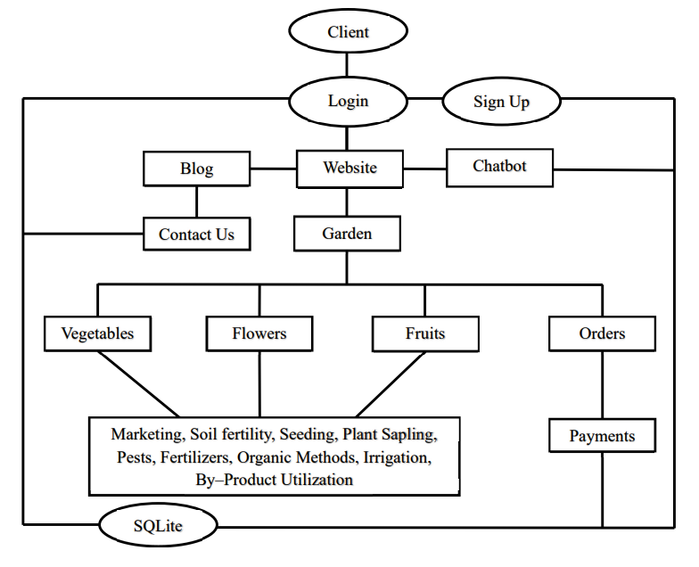
PROJECT FLOW
Project Flow of Harnessing Technologies to Enhance Crop Production

Slide 15
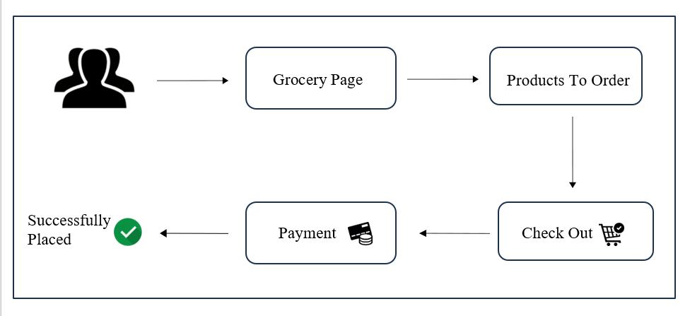
Project Flow of Marketing Management

Slide 16
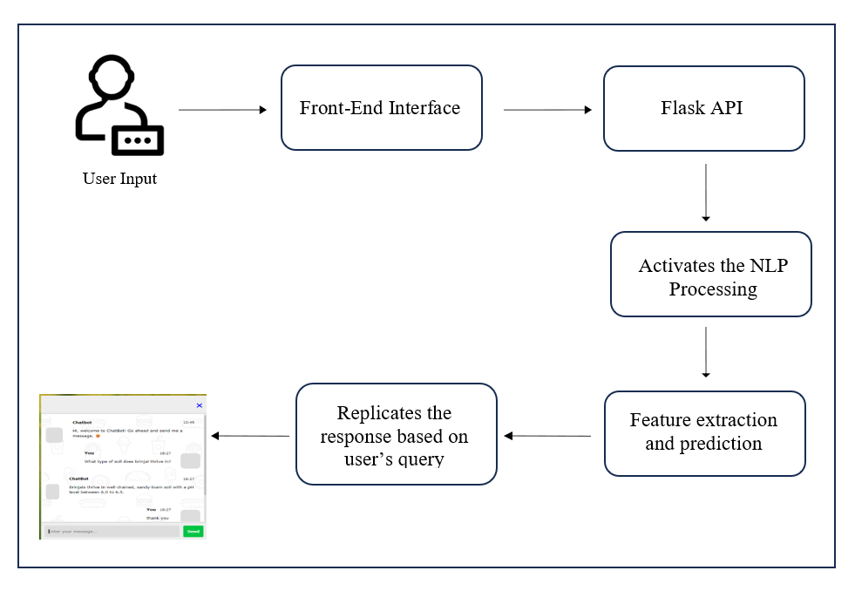
Project Flow of Chat Bot

Slide 17
ALGORITHMS USED
Modules / APIs / Algorithms Used:
Flask API : Framework for building web applications and APIs in Python which is flexibility and simplicity.
Translator API : Framework used for converting text translation making user-friendly.
TensorFlow : Framework used for training the CNN model
Keras : for providing a high level of abstraction.
Flask : Library used in python for accessing flask API.
Nltk : Library used in python for accessing Natural Language Processing(NLP).
NumPy : Library in python used for accessing images in array format.

Slide 18
MODULES
Chat Bot:
In this, the model helps in communicating with client if there is any problem with the yield. The Chat Bot makes the user to get user-friendly understanding of the website.
Text Translator:
Translation is the process of reworking text from one language into another to maintain the original message and communication client can communicate in any language.
API:
This module protects the information of all clients and conversations of all clients, using the google translator API.
Marketing Management:
This module is useful for client in which they can directly sell their products or buy the products from other clients. There is no involvement in third party persons like agent or wholesalers.

Slide 19
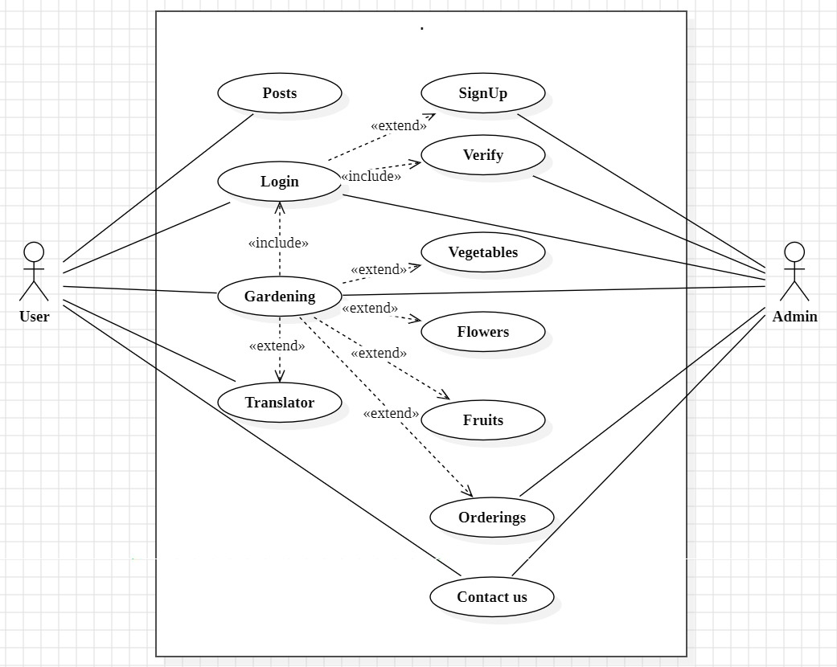
UML DIAGRAMS
USE CASE DIAGRAM:
The following shown figure is the Use-case diagram of our proposed project.
It describes what the system does and how the system operates internally.

Slide 20
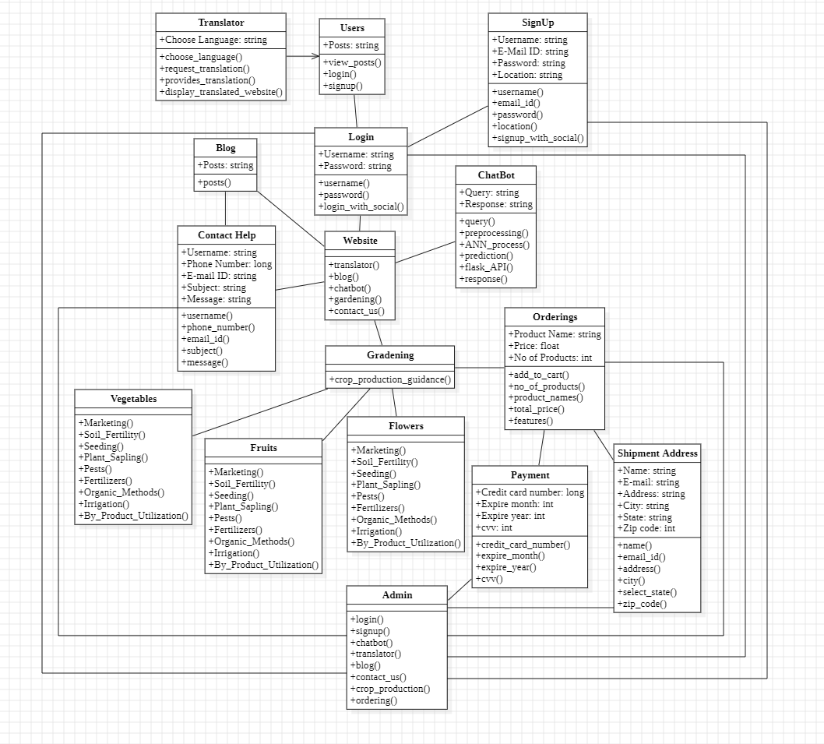
UML DIAGRAMS
2. CLASS DIAGRAM:
The following shown figure is the Class diagram of our proposed project.
It is used to model the objects that make up the system, to display the relationships between the objects and to describe what those objects do and the services that they provide.

Slide 21
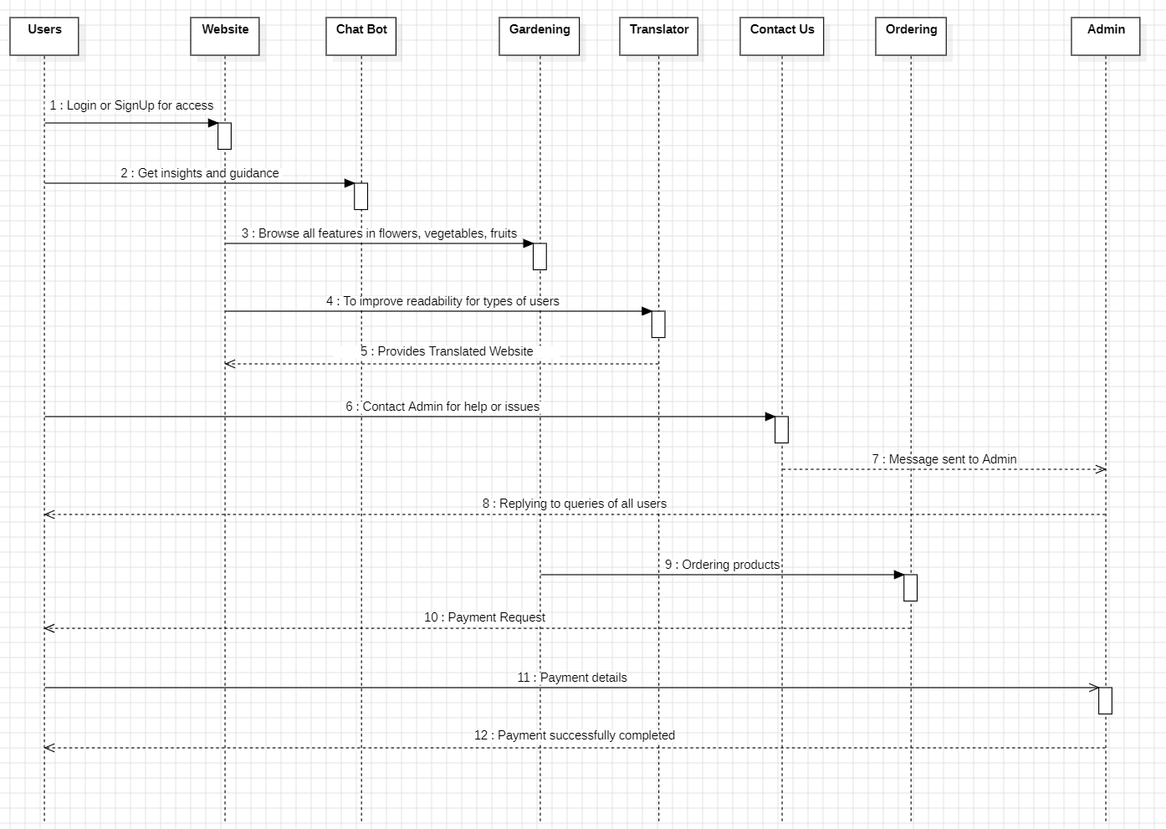
UML DIAGRAMS
3. SEQUENCE DIAGRAM:
The following diagram is the Sequence diagram of Harnessing Technologies to Enhance Crop Production.
This sequence diagram consists of four objects the User, Chatbot, Translator, Market management.
It shows the sequence of actions between the user and the feature full end crop production system.

Slide 22
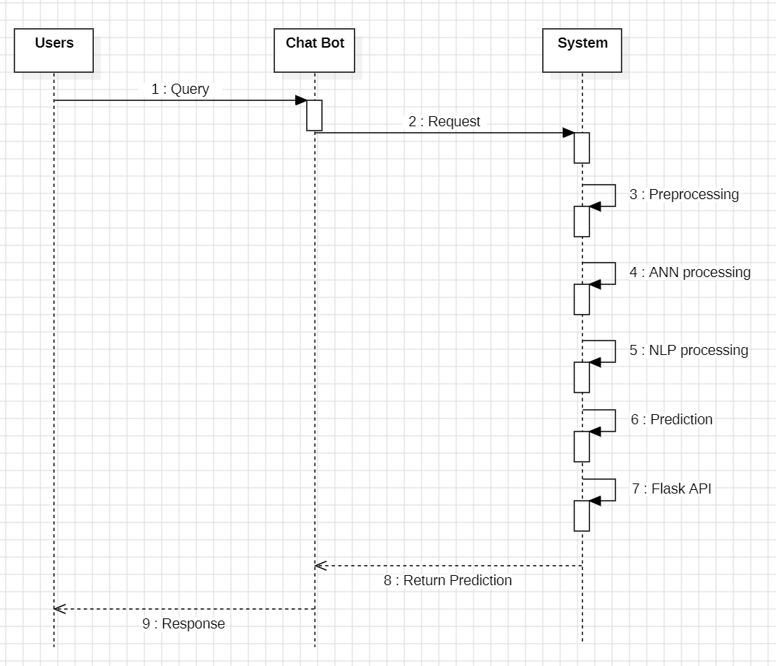
UML DIAGRAMS
The following diagram is the Sequence diagram of Chat Bot working.
This sequence diagram consists of three objects the Users, Chat Bot, System.
It shows the sequence of actions between the Users and the Chat Bot.

Slide 23
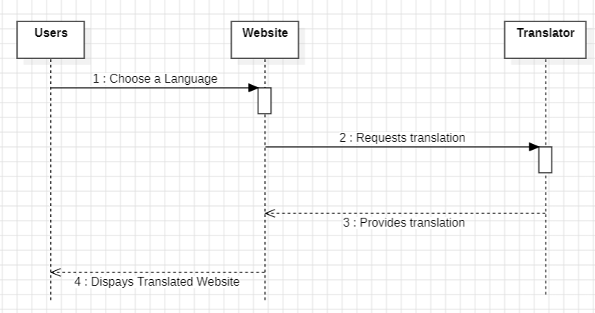
UML DIAGRAMS
The following diagram is the Sequence diagram of translator
This sequence diagram consists of three objects the Users, Website, Translator.
It shows the sequence of actions between the user and the feature Translator.

Slide 24
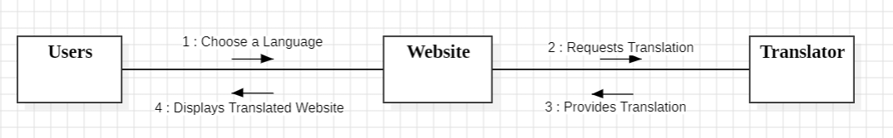
UML DIAGRAMS
4. COLLABORATION DIAGRAM:
The shown figure is the Collaboration diagram of translator working in website.
This figure shows how the user communicates with the web application when he selects translator the API takes request and translates to the user’s required language.

Slide 25
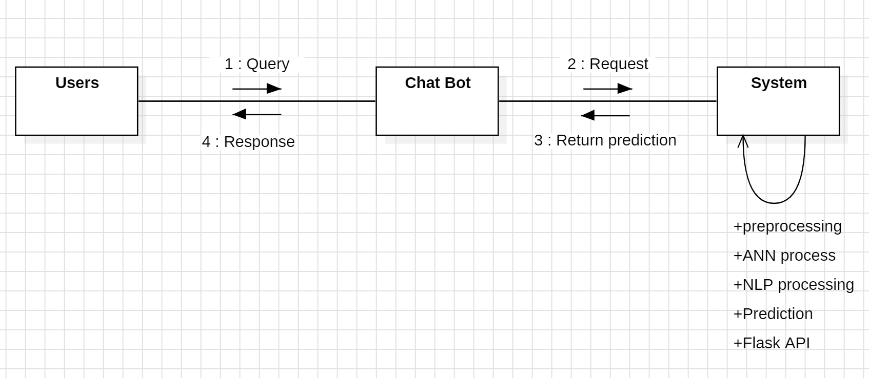
UML DIAGRAMS
The below shown figure is the Collaboration diagram of Chat Bot
This above diagram shows the interactions between the user and the application when the user selects chat bot to interact with it for guidance and help which connects to the System.

Slide 26
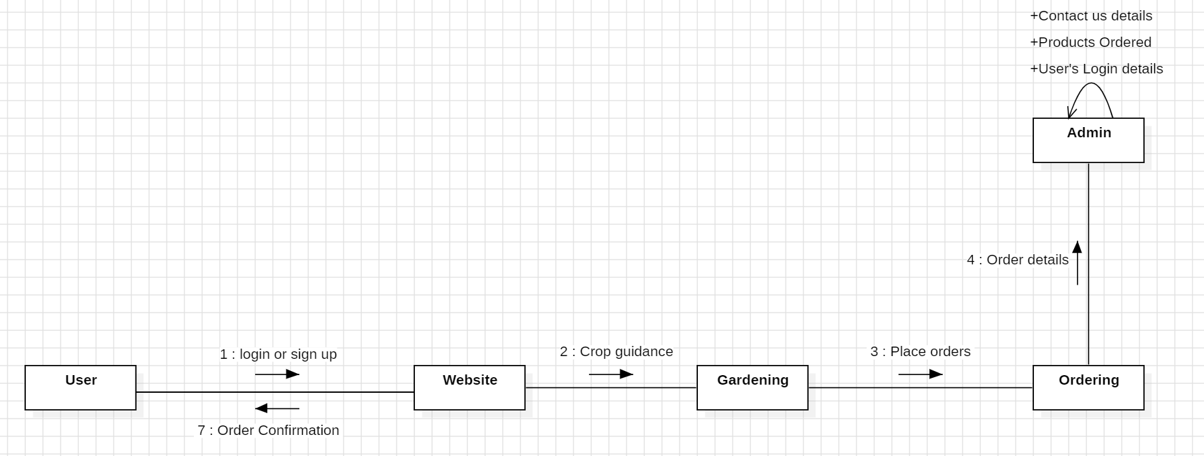
UML DIAGRAMS
The below shown figure is the Collaboration diagram of Harnessing Technologies to Enhance Crop Production.
When the user want to use the web application, the internal communication between the web application and user to get secured and flexible insights and guidance along with marketing strategies is represented in the shown Collaboration diagram.

Slide 27
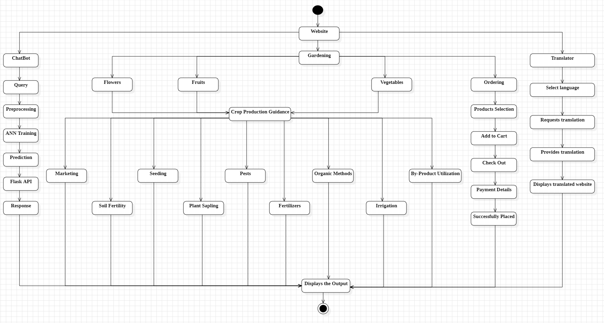
UML DIAGRAMS
5. STATECHART DIAGRAM
The states in the diagram are represented in soft cornered rectangle and describes the behavior of objects that act different according to the state.
The following shown figure is the state chart diagram of the proposed model.

Slide 28
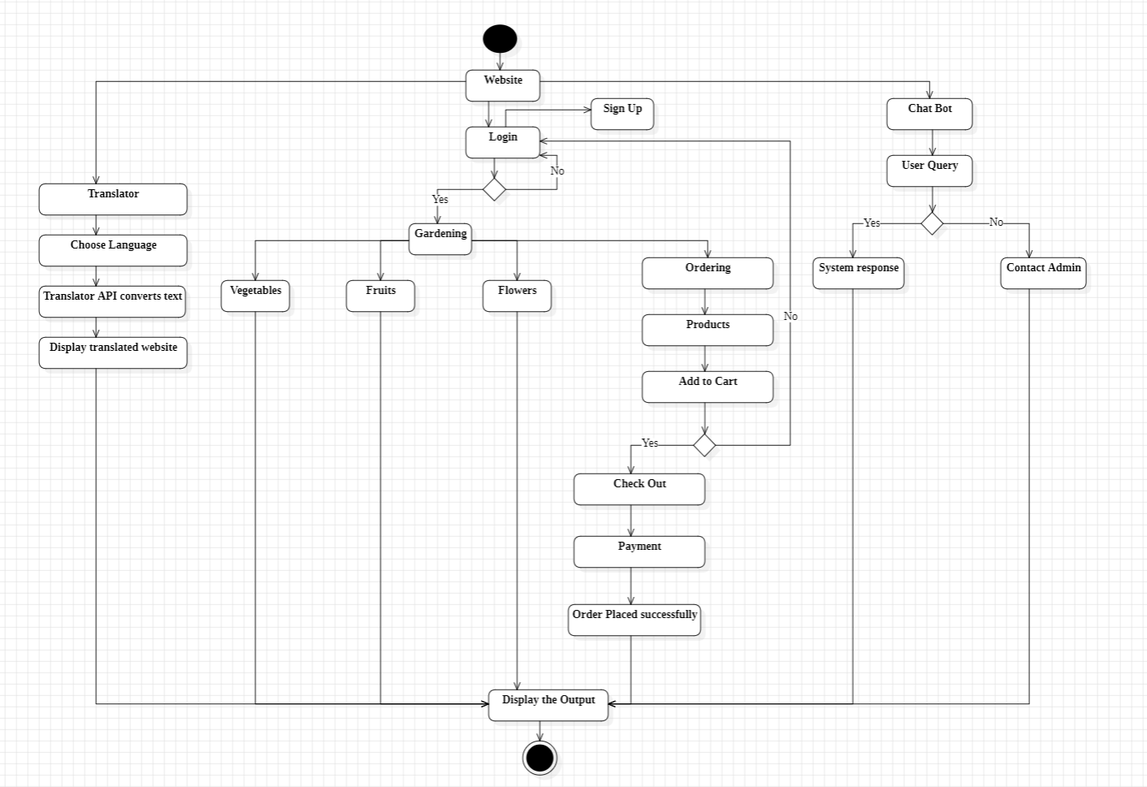
UML DIAGRAMS
6. ACTIVITY DIAGRAM:
The shown figure is the activity diagram of the proposed model.
It displays the sequence of activities and function of a system and emphasize the flow of control among objects.

Slide 29
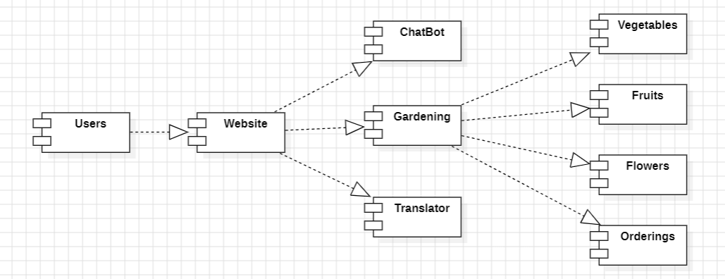
UML DIAGRAMS
7. COMPONENT DIAGRAM:
A component Diagram displays the Structural relationship of components of a software system of our proposed model
The below shown figure is the Component Diagram of the proposed diagram.

Slide 30
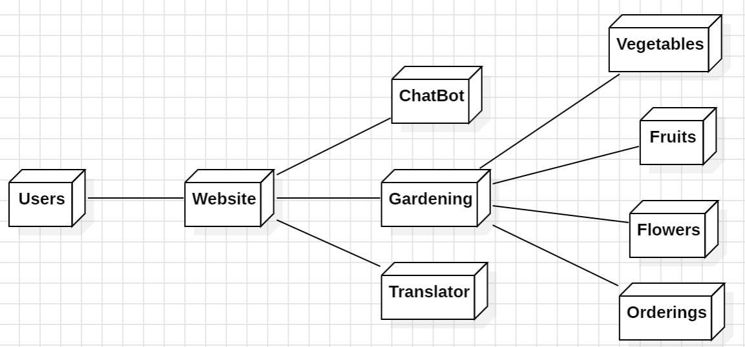
UML DIAGRAMS
8. DEPLOYMENT DIAGRAM:
A Deployment Diagram shows the hardware of your system and the software in that hardware of the proposed project.
The below shown figure is the Deployment diagram of the proposed project.

Slide 31
TESTING
Testing: The process of executing a program to find errors. To make our software perform well, it should be error-free.
Unit Testing: During this first round of testing, the program is submitted that focus on specific units or components of the software to determine whether each one is fully functional.
Integration Testing: Integration testing allows individuals the opportunity to combine all of the units within a program and test them as a group. This testing level is designed to find interface defects in modules/functions.
Verification Testing: Verification Testing checks to authenticate that the system design and architecture are accurately engineered and free of errors. Verification checks are something like studying the specifications and checking them against the code logic.
Validation Testing: Validation Testing is an activity that ensures that an end product stakeholders true needs and expectations are met. Its main intent is to check that the final product matches the stakeholder and customer requirements.

Slide 32
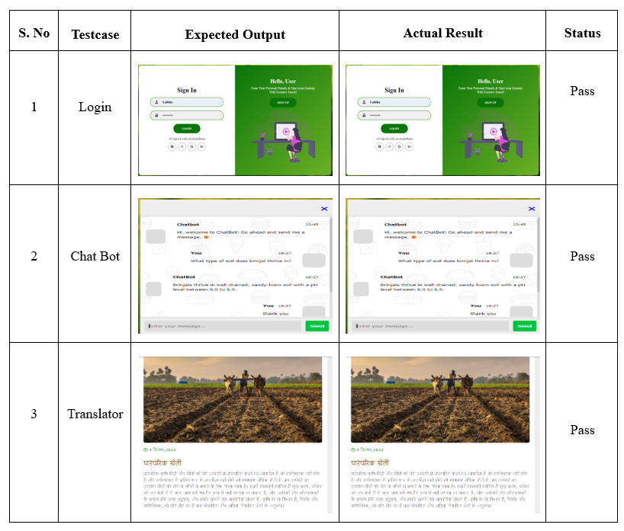
TESTCASES
Here are some testcases taken to evaluate some of the features of project:

Slide 33
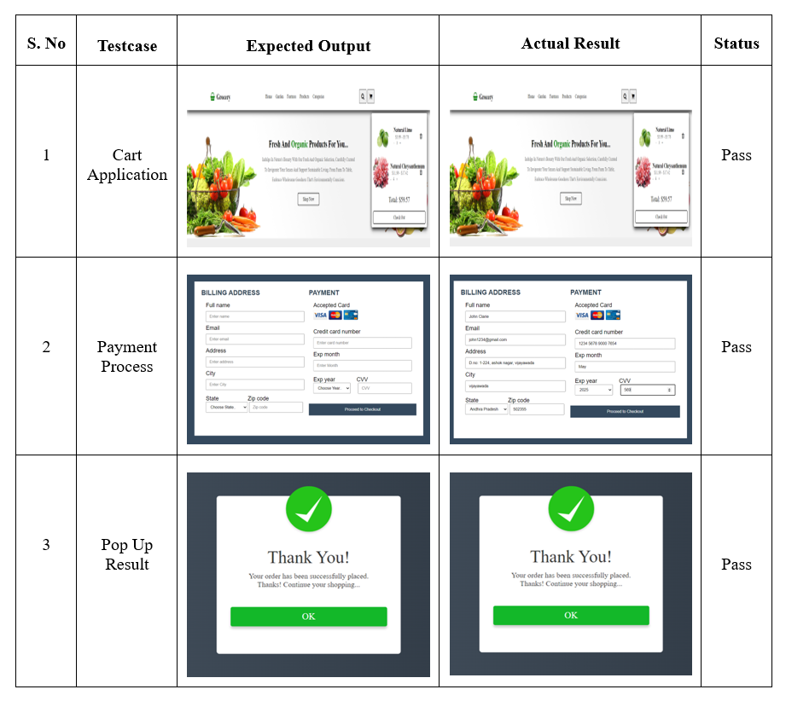
TESTCASES
Here are some testcases taken to evaluate the Marketing Management:

Slide 34
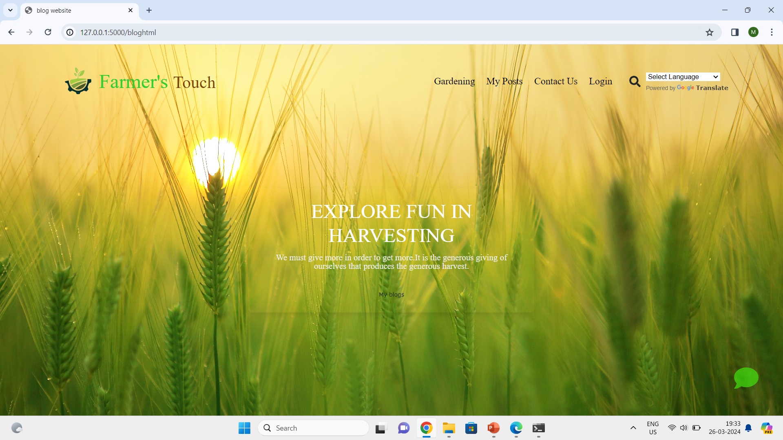
RESULTS
Main Page of the Farmer’s Touch

Slide 35
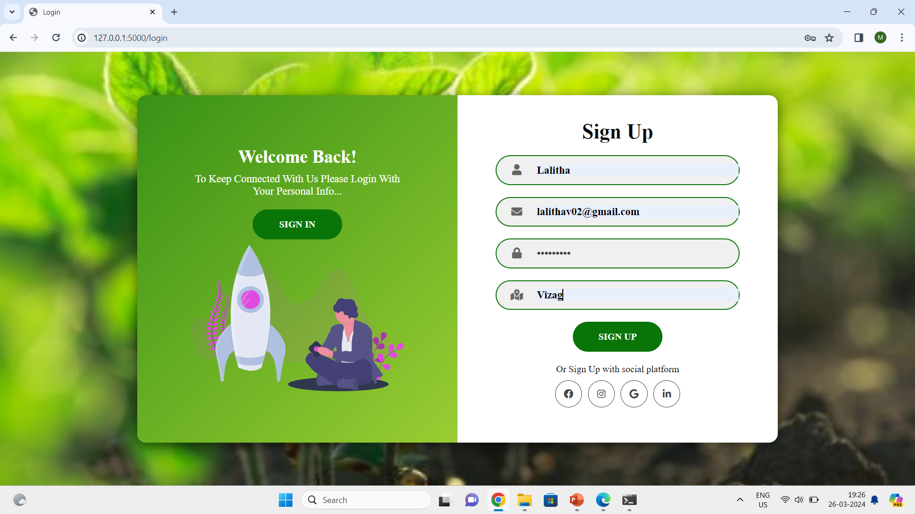
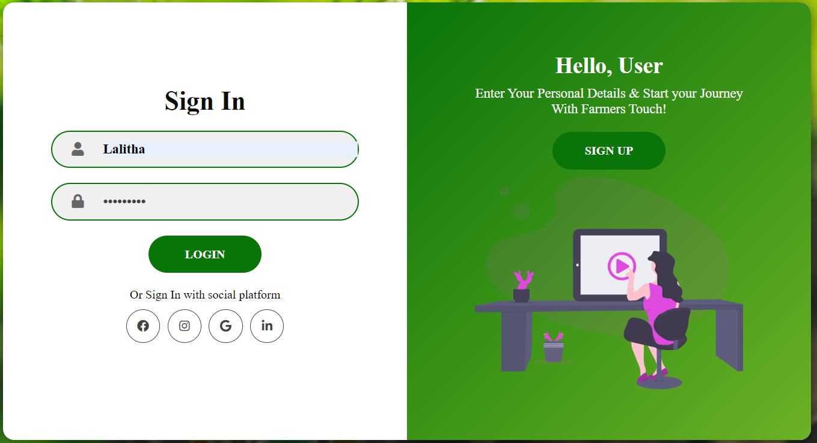
SignUp Page to access the page
Login Page to access the page

Slide 36
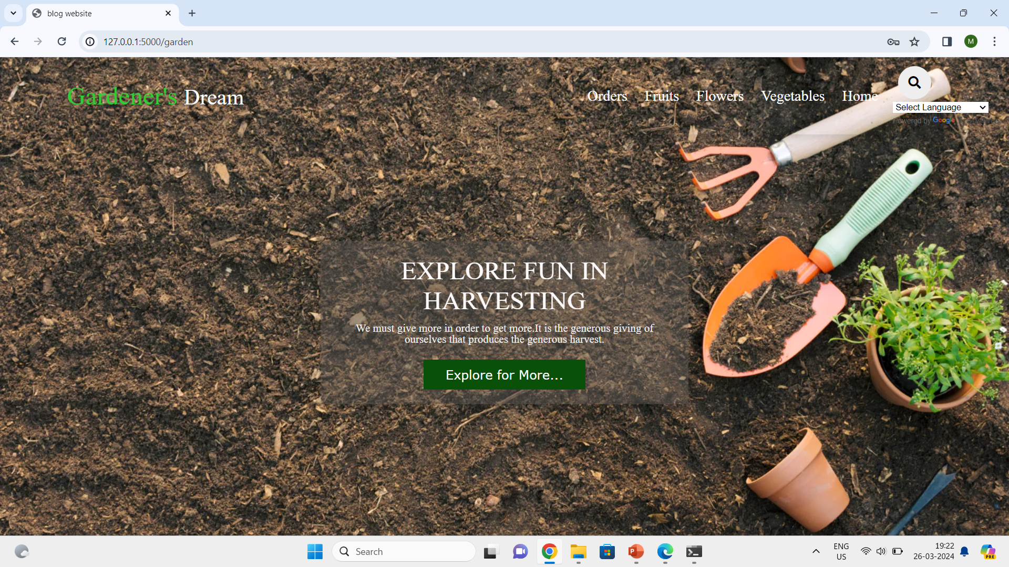
Redirection to Gardener’s page after Signup/Login

Slide 37
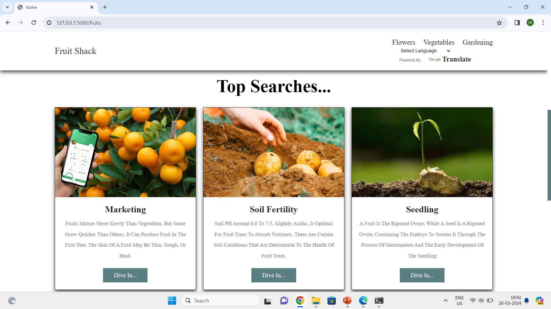
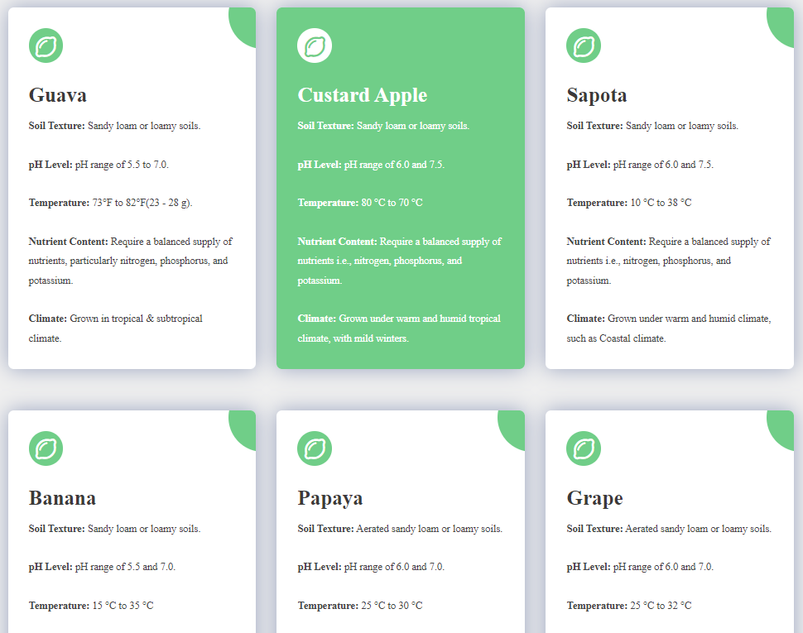
Crop Production Guidance of Fruits from soil to marketing
One of example of crop guidance about soil fertility

Slide 38
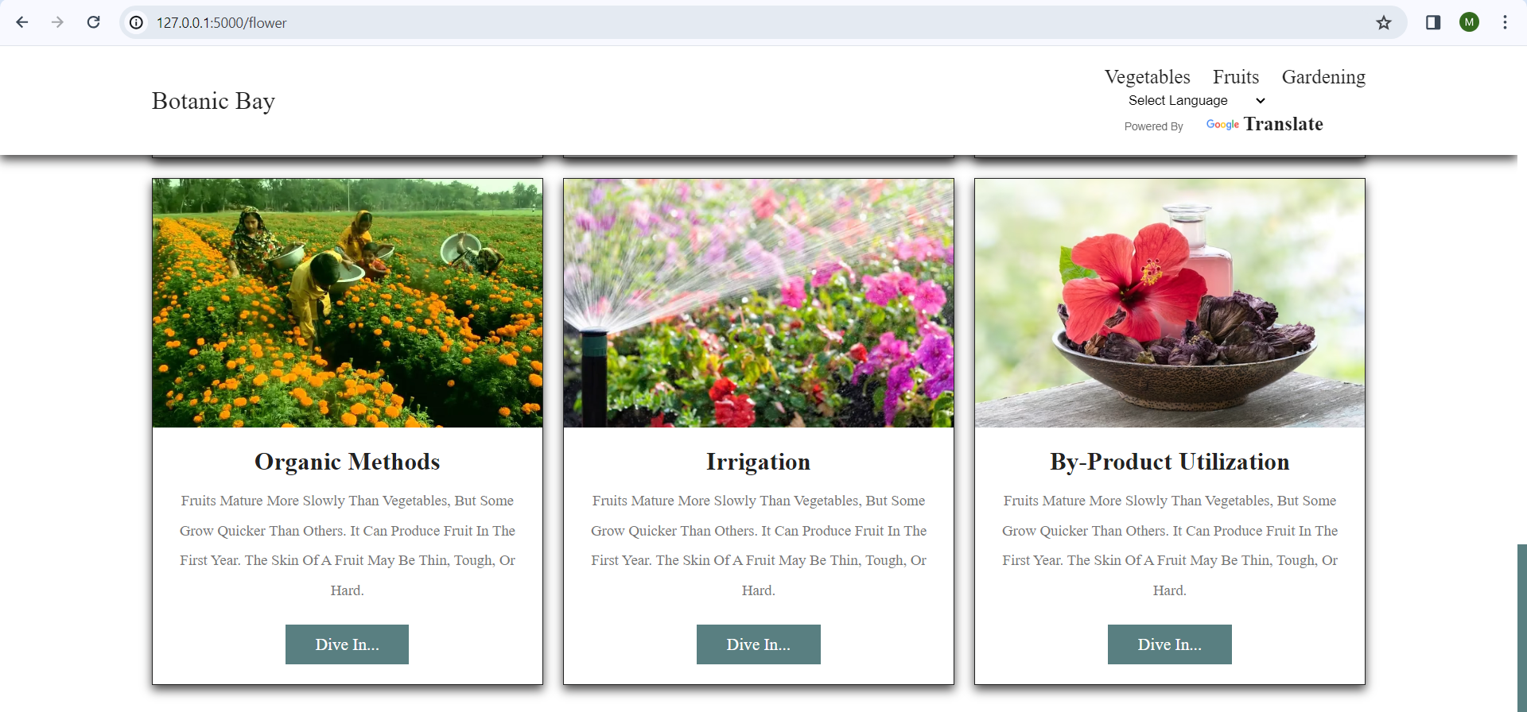
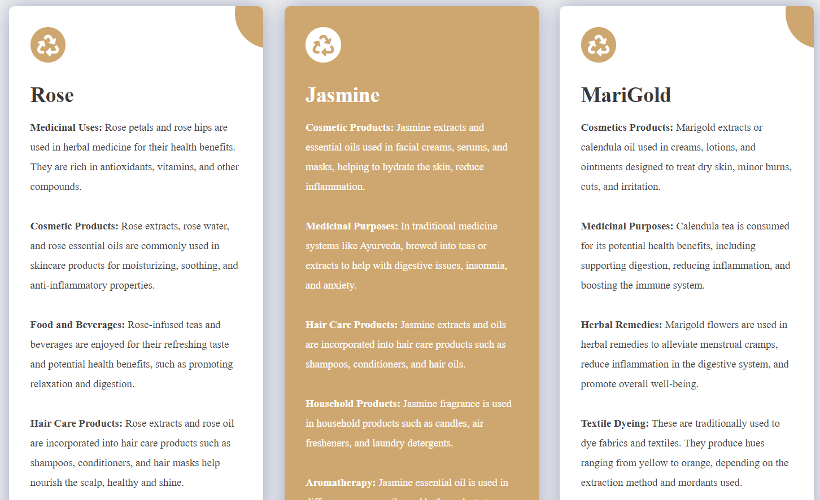
Crop Production Guidance of Flower from soil to marketing
One of example of crop guidance about By-Product Utilization

Slide 39
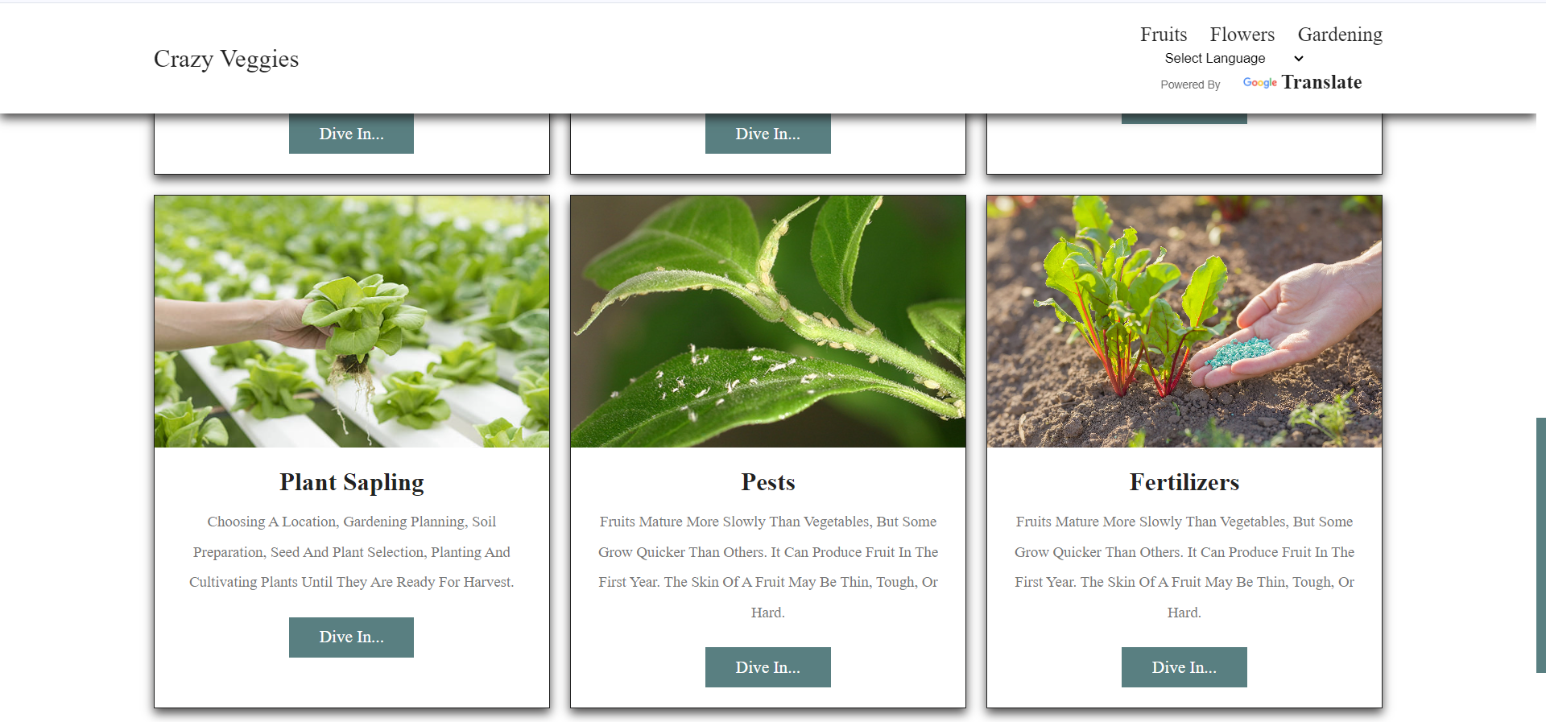
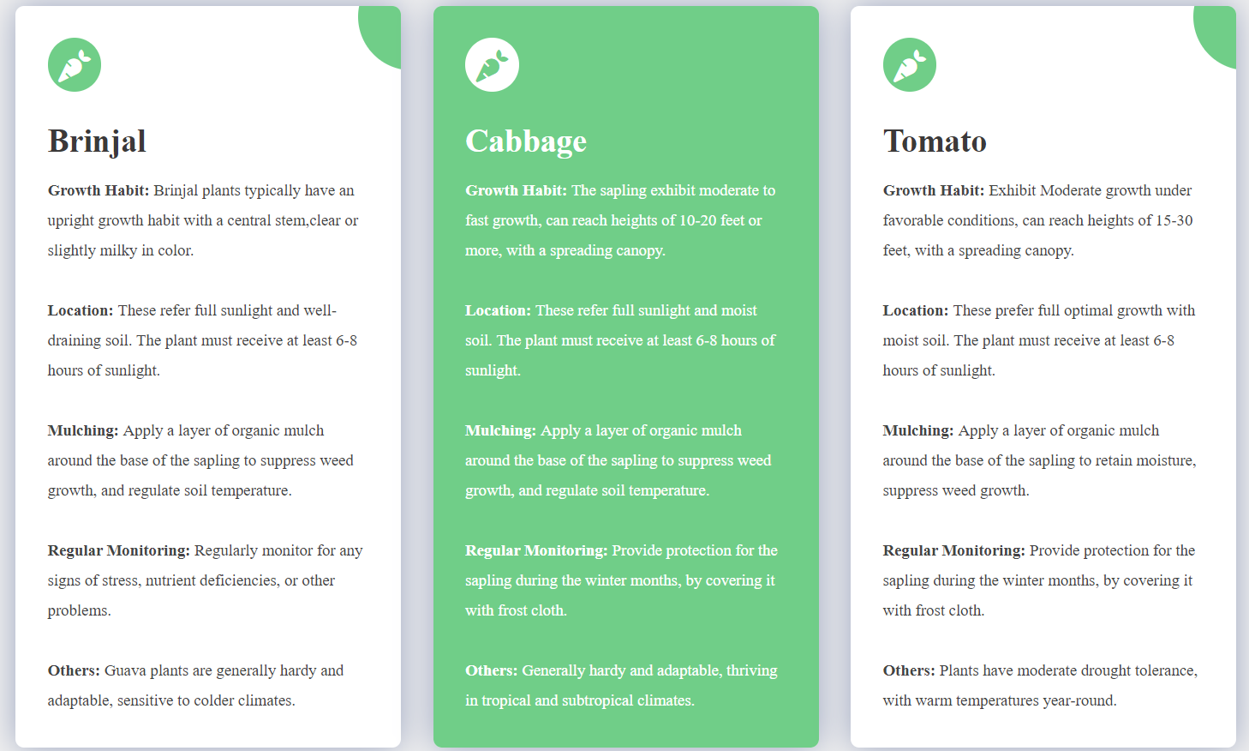
Crop Production Guidance of Vegetable from soil to marketing
One of example of crop guidance about By-Product Utilization

Slide 40
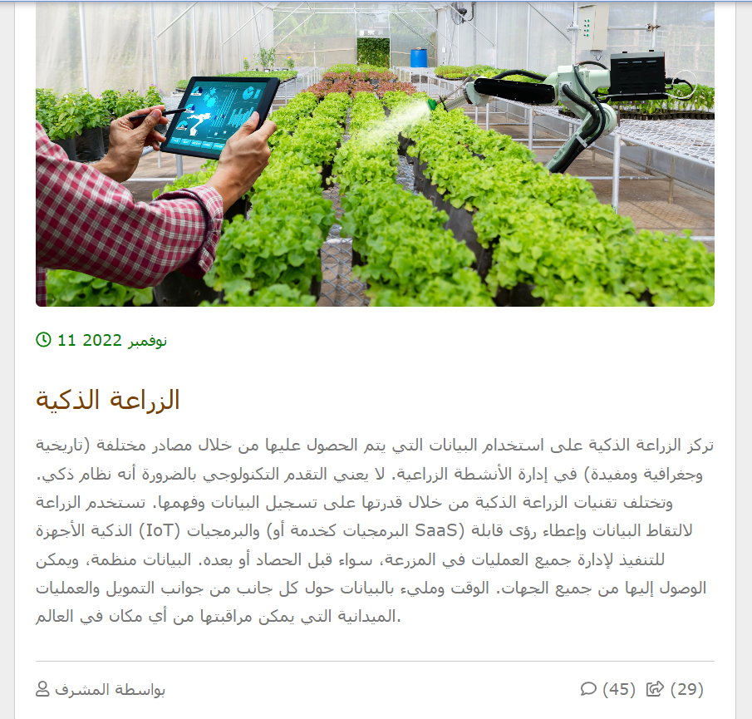
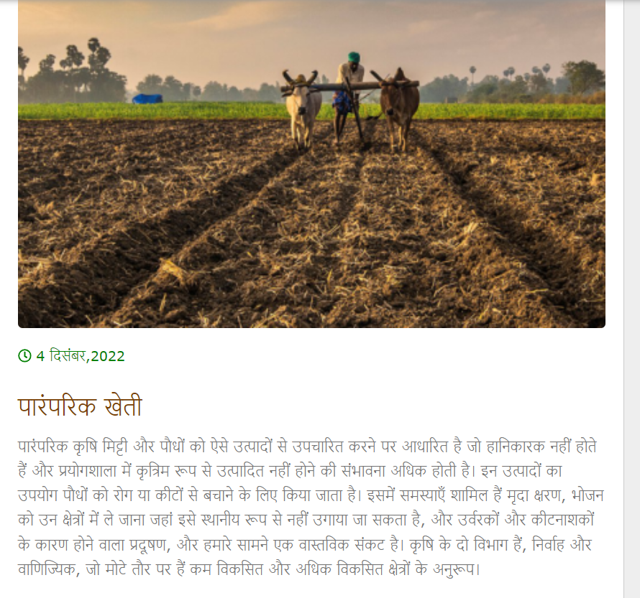
Example1 of Text Translator
Example 2 of Text Translator

Slide 41
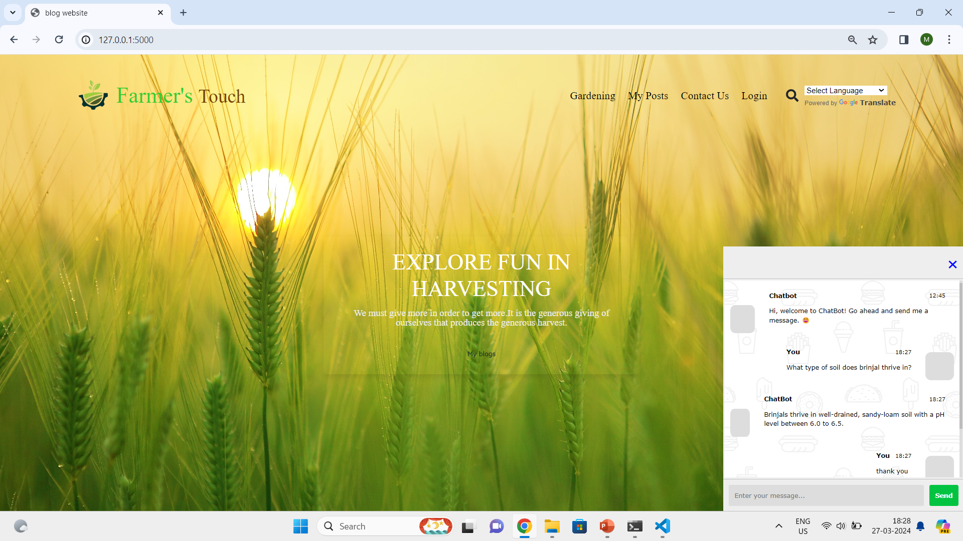
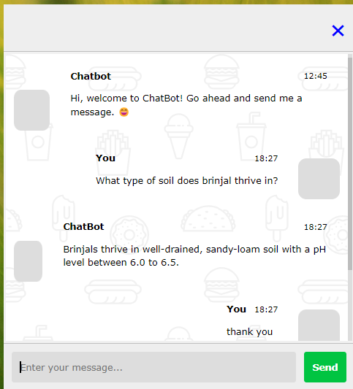
Chat Bot convo for the users get flexible data & access
Chat Bot conversation based on the training

Slide 42
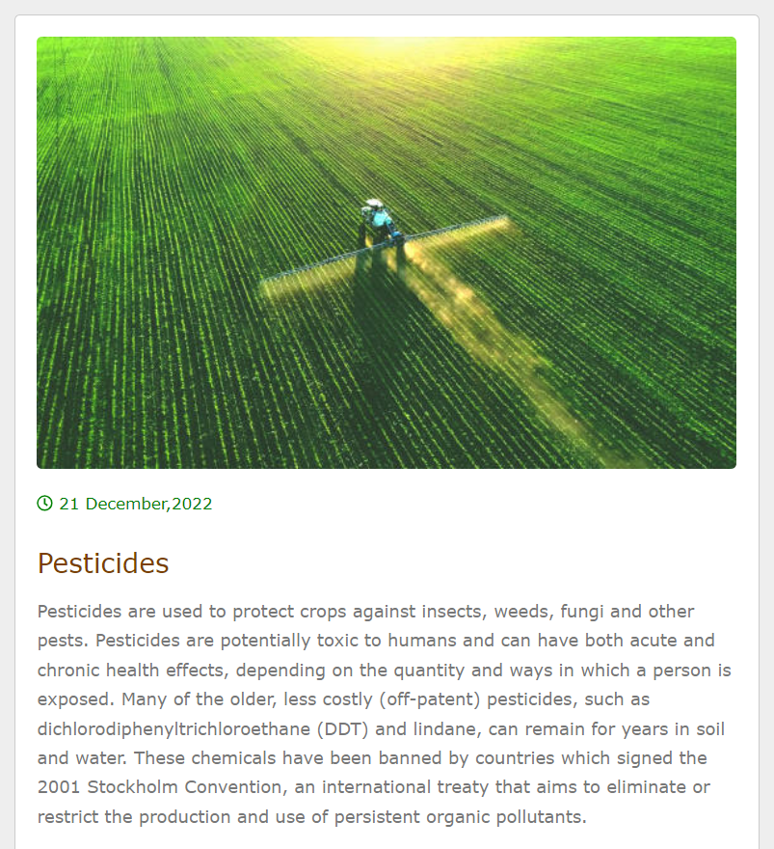
Blog Content to get updates on agriculture field

Slide 43
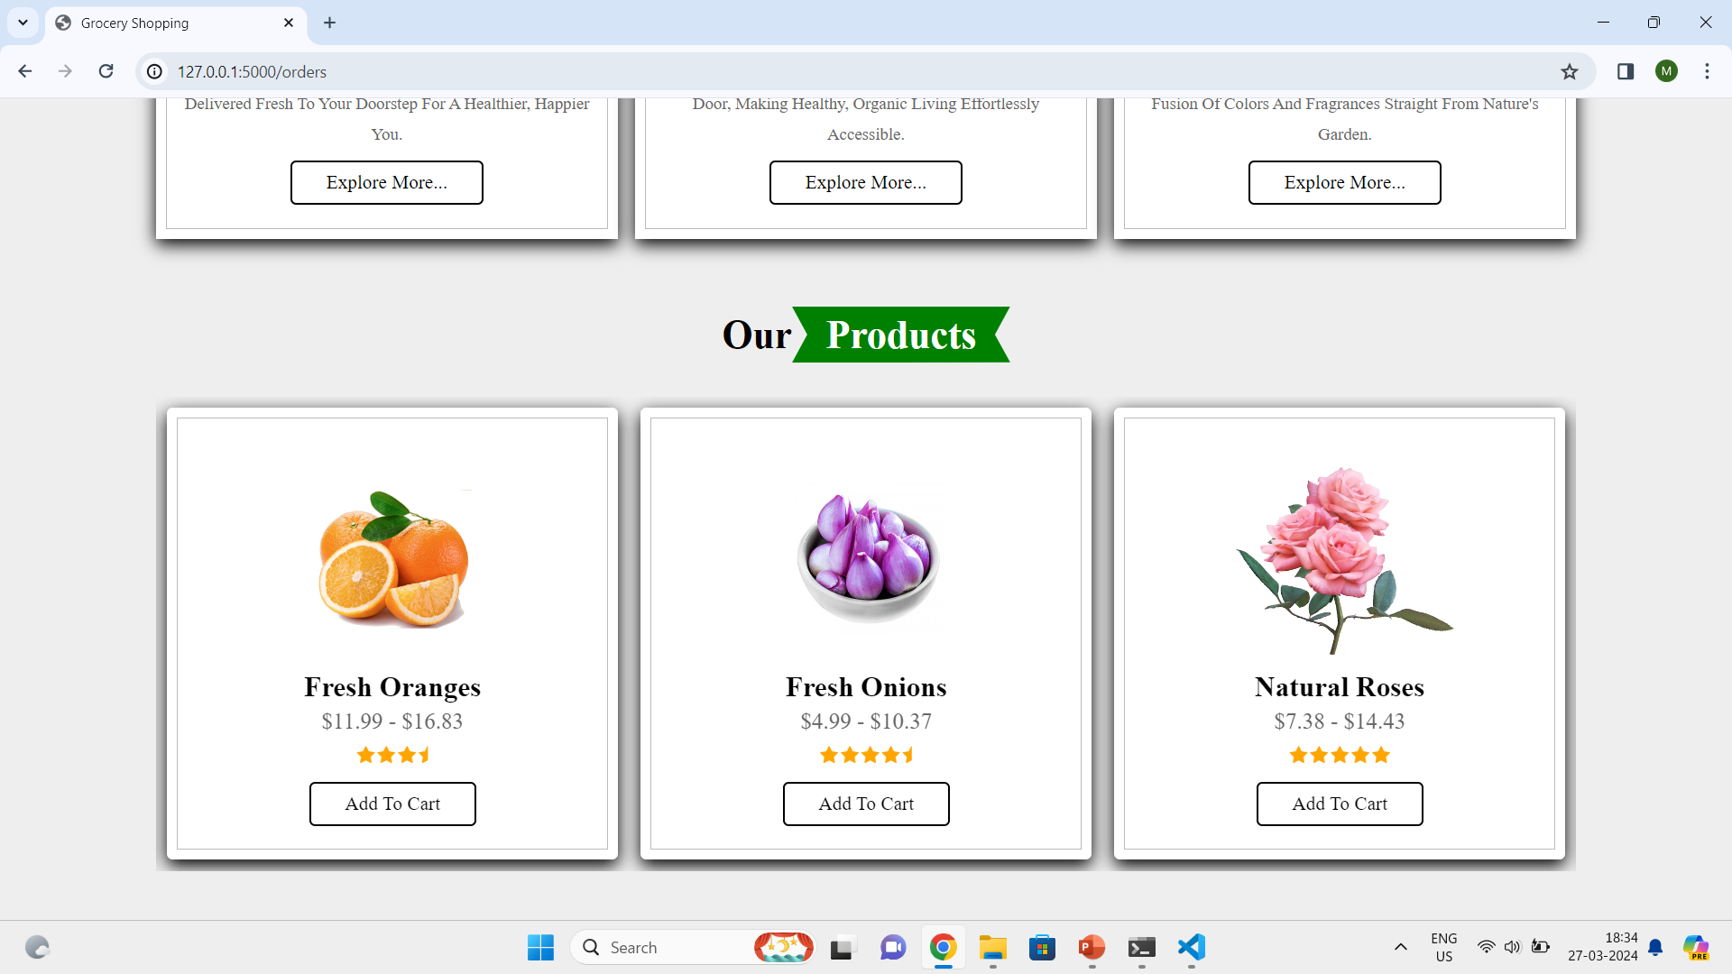
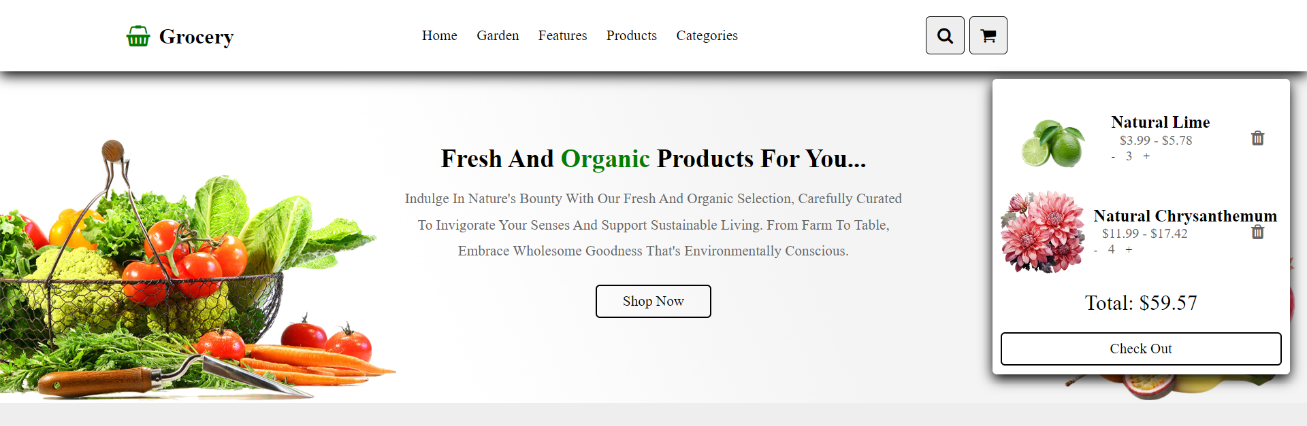
Scrollable Grocery Marketing Management
Products that are in Cart to Go

Slide 44
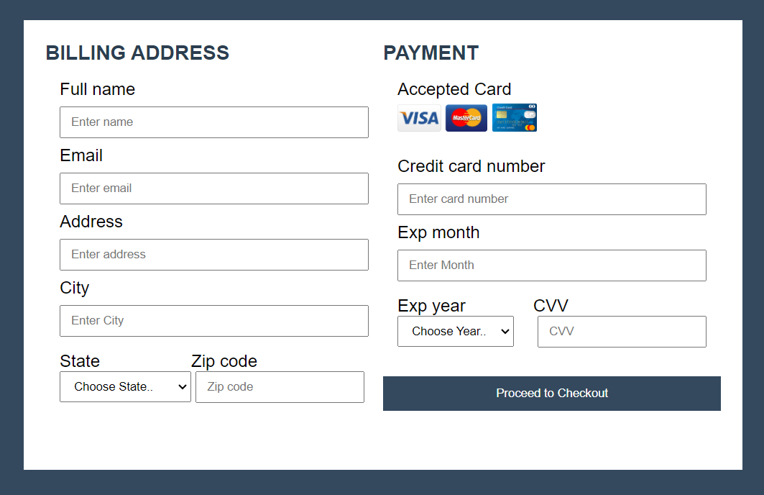
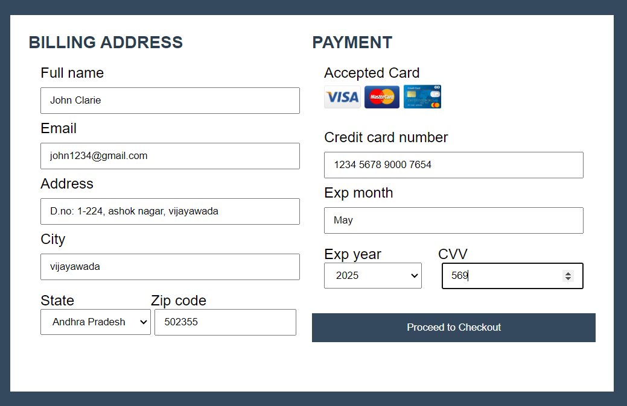
Payment Process to buy natural goods

Slide 45
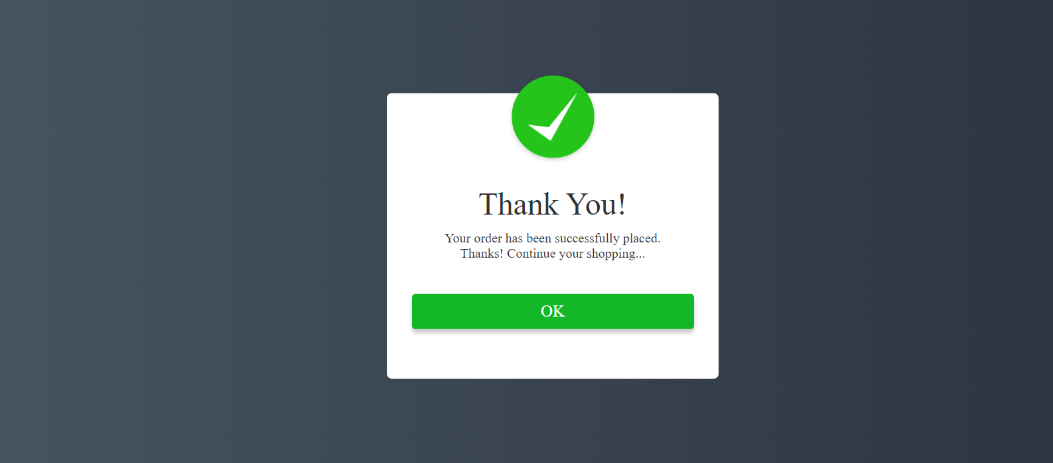
Output of Grocery Marketing Management

Slide 46
CONCLUSION
In conclusion, modern agricultural practices, particularly Precision Agriculture (PA), promise high productivity while conserving resources. This project utilizes advanced technologies like sensors and machine learning to democratize expert guidance.
The integration of a multilingual chatbot further enhances accessibility, ensuring that language barriers do not hinder users from accessing crucial information.
Users receive tailored recommendations for soil management, pest control, and machinery utilization. Integration of a multilingual chatbot enhances accessibility, overcoming language barriers.
This full-stack project acts as a virtual hub for agricultural knowledge, empowering users to optimize crop growth and yields efficiently.

Slide 47
FUTURE SCOPE
In the future this project can enhance, “Harnessing Technologies To Enhance Crop Production" project is the growing set of challenges faced by modern agriculture.
The project's primary objective is to reduce manual labor dependency, enhance food security, promote sustainability, and provide data-driven decision-making through the integration of technologies such as AI, IoT, and robotics.
The use of autonomous farming technologies for tasks like planting, irrigation, and harvesting. The AI-driven crop monitoring and data analytics can be used for data-driven decision-making.
The “Marketing Management” can be the important feature that user can seek for the further extensive marketing opportunities by following the extension or features of B2B or B2C strategies to the web application.

Slide 48
TABLE FOR STUDENT CONTRIBUTION
S. No | Tasks | 21A95A0506 | 20A91A0512 | 20A91A0506 | 20A91A0523
1. | Literature Survey | - | - | Referred Agriculture based projects | Referred Agriculture based research papers in IEEE
2. | Problem Formulation | Based on Survey, came with 50% of problem statement | Based on Survey, came with 50% of problem statement | - | -
3. | Requirements Gathering | - | - | Reached out and analyzed requirements | Reached out and analyzed requirements
4. | Resource Estimation | Estimated the required software and resources for project | Estimated the required software and resources for project | - | -
5. | Documentation | Documenting on the full stack modules | - | Documenting on the Chat Bot modules | -
6. | PPT Presentation | - | Preparation of the PPT presentations | - | Preparation of the PPT presentations

Slide 49
REFERENCES
[1] Jalal Uddin Md Akbar, Syafiq Fauzi Kamarulzaman, Abu Jafar Md Muzahid, Md. Arafatur Rahman, Mueen Uddin[2024] “A Comprehensive Review on Deep Learning Assisted Computer Vision Techniques for Smart Greenhouse Agriculture” IEEE Access DOI: 10.1109/ACCESS.2024.3349418
[2] Ahmad Ali AlZubi and Kalda Galyna,[2023] “Artificial Intelligence and Internet of Things for Sustainable Farming and Smart Agriculture” IEEE Access DOI: 10.1109/ACCESS.2023.3298215
[3] Rongji Zhou and Yuyan Yin[2023] “Digital Agriculture: Mapping Knowledge Structure and Trends” IEEE Access DOI: 10.1109/ACCESS.2023.3315606

Slide 50
[4] Nayeli Montalvo-Romero, AarónMontielRosales, Rubén Purroy-Vásquez, Pompeyo Quechulpa-Pérez(2023) “Agro-Technological Systems in Traditional Agriculture Assistance: A Systematic Review” IEEE Access DOI:10.1109/ACCESS.2023.3329087
[5] Sarah Condran, Michael Bewong, Md Zahidul Islam, Lancelot Maphosa and Lihong Zheng[2022] “Machine Learning in Precision Agriculture: A Survey on Trends, Applications and Evaluations Over Two Decades” IEEE Access DOI: 10.1109/ACCESS.2022.3188649
[6] Giovanni Almeida Santos, Guilherme Guy de Andrade, Geovana Ramos Sousa Silva, Francisco Carlos Molina Duar[2022] “A Conversation-Driven Approach for Chatbot Management” IEEE Access DOI: 10.1109/ACCESS.2022.3143323

Slide 51
[7] Showkat Ahmad Bhat; Nen-Fu Huang[2021] “Big Data and AI Revolution in Precision Agriculture: Survey and Challenges” IEEE Access DOI: 10.1109/ACCESS.2021.3102227
[8] Syeda Iqra Hassan, Mazliham Mohd Su’ud , Sultan H. Almotiri , Mohammed A. Al Ghamdi , Usman Illahi , Muhammad Mansoor Alam [2021] “A Systematic Review on Monitoring and Advanced Control Strategies in Smart Agriculture” IEEE Access DOI: 10.1109/ACCESS.2021.3057865
[9] Abhinav Sharma, Arpit Jainm, Prateek Gupta, Vinay Chowdary[2020] “Machine Learning Applications for Precision Agriculture: A Comprehensive Review” IEEE Access DOI: 10.1109/ACCESS.2020.3048415

Slide 52
[10] Addi Ait-Mlouk, Lili Jiang[2020] “KBot: A Knowledge Graph Based ChatBot for Natural Language Understanding Over Linked Data” IEEE Access DOI: 10.1109/ACCESS.2020.3016142
[11] Khang Nhut Lam, Loc Huu Nguy, Van Lam Le, Jugal Kalita[2023]: “A Transformer-Based Educational Virtual Assistant Using Diacriticized Latin Script” IEEE Access DOI: 10.1109/ACCESS.2023.3307635
[12] Girija Attigeri, Ankit Agrawal, Sucheta V. Kolekar[2024]: “Advanced NLP Models for Technical University Information Chatbots: Development and Comparative Analysis” IEEE Access DOI: 10.1109/ACCESS.2024.3368382

Slide 53
WEB LINKS
https://github.com/christianversloot/machine-learning-articles/blob/main/how-to-use-h5py-and-keras-to-train-with-data-from-hdf5-files.md
https://realpython.com/build-a-chatbot-python-chatterbot/#step-2-begin-training-your-chatbot
https://www.tutorialspoint.com/python_text_processing/python_text_translation.htm
hhttps://www.youtube.com/watch?v=70H_7C0kMbI
https://www.youtube.com/watch?v=Jzv3G5iDLvw
https://www.youtube.com/watch?v=rfHq9HVdRqw
https://www.youtube.com/watch?v=uhtHS3-3PqQ&t=4s
https://www.geeksforgeeks.org/flask-role-based-access-control/
https://sloboda-studio.com/blog/how-to-use-nlp-for-building-a-chatbot/

